Slide 1
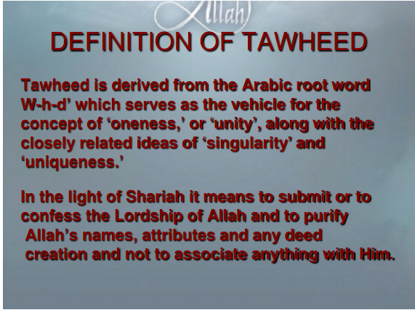

Slide 2
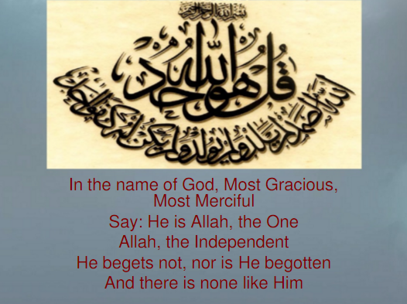

Slide 3
THE ENTITY OF ALLAH
Allah is the entity that has created the whole universe.
اَللّٰهُ خَالِقُ كُلِّ شَيْءٍ
Allah is different from all other beings and none is similar to Him
لَيْسَ كَمِثْلِهٖ شَيْءٌ
He is beyond the imagination and can’t be compared.
وَلِلّٰهِ الْمَثَلُ الْاَعْلٰى
He begets not, nor was He begotten.
لَمْ يَلِدْ وَلَمْ يُوْلَدْ

Slide 4
Attributes of Allah
Al Awal: He is eternal, the everlasting and the self existing. He exists of His own.
Al Wahid: He posses the glory of being one
Al Khaliq: He is the only creator.
Al Aleem: He is the one who knows everything
Al Ghaffar: He is the one who forgives
Al Naseer: He is the one from whom we seek help

Slide 5
ARGUMENTS ABOUT THE EXISTENCE OF ALLAH
The discipline and control of the universe.
Argument from agriculture
Argument from milking animals.
Argument from air and water
Argument from cause and effect
Different creative stages of a man

Slide 6
KINDS OF TAUHEED
believing that Allah is one and unique in His being(lordship)
believing that Allah is one and unique in His attributes( sifat)
believing that Allah is one and unique in the implication of His attributes/ in His right to be worshiped

Slide 7
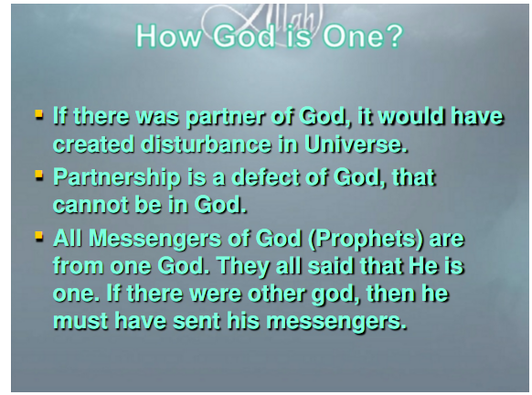

Slide 8
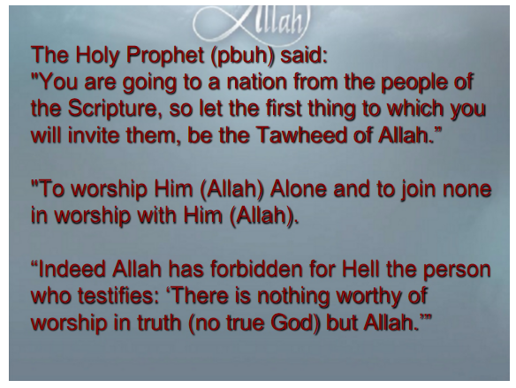

Slide 9
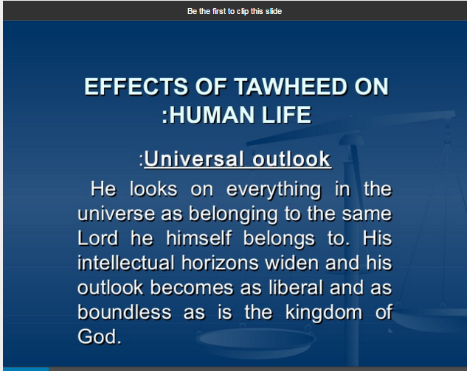

Slide 10
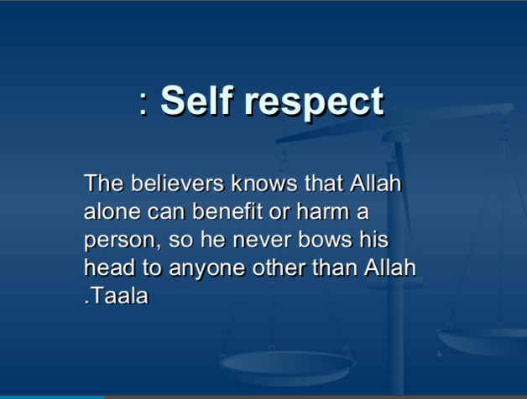

Slide 11
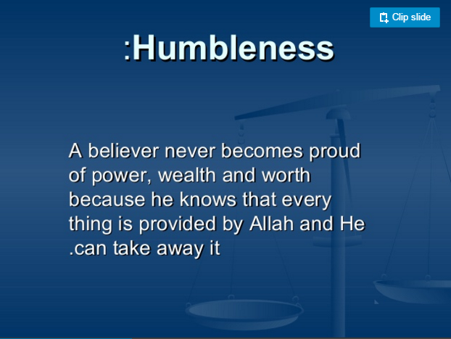

Slide 12
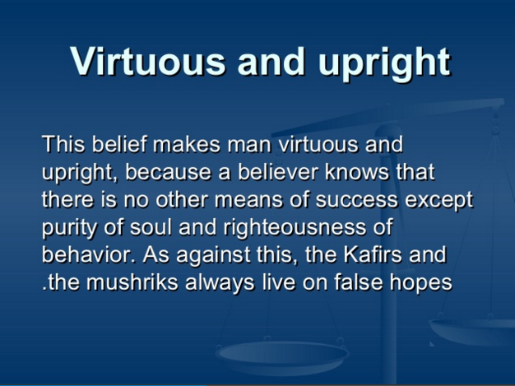

Slide 13
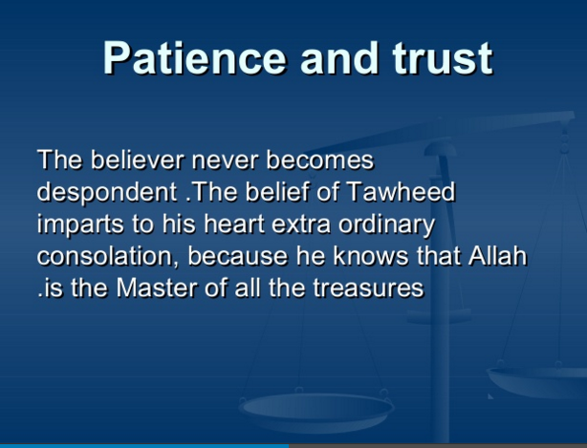

Slide 14
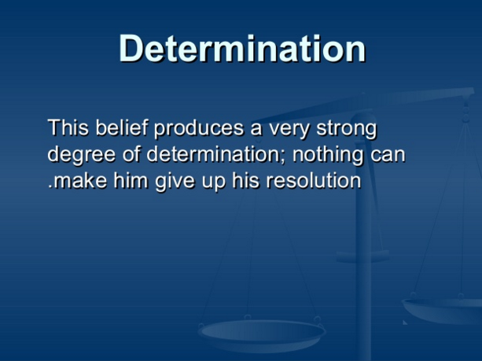

Slide 15
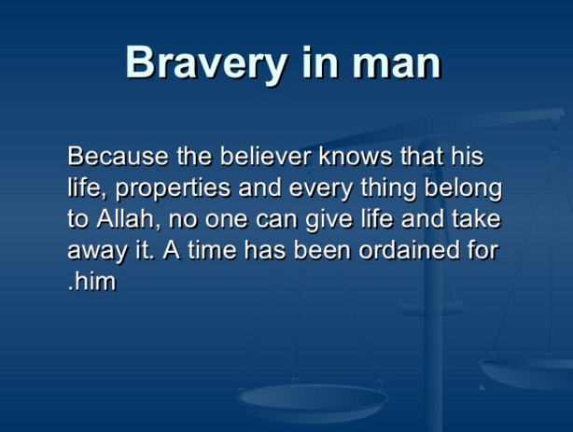

Slide 16
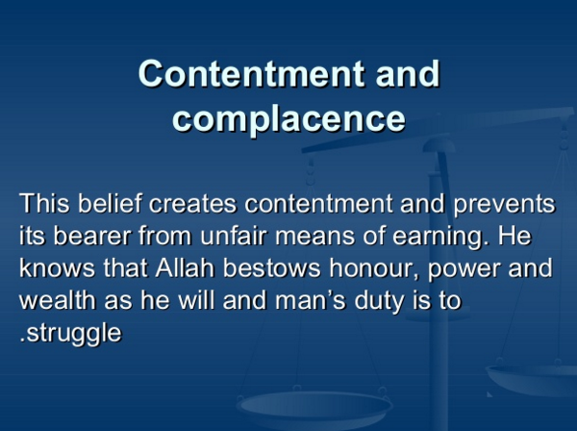

Slide 17
